Slide 1
A+ Computer Science
Number Systems

Slide 2
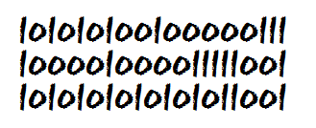
Number Systems
What is the Standard Base we
work with in our everyday lives?
Why do we work in that base?

Slide 3
Number Systems
2 – 10100100
8 - 5672
10 – 78645
16 – ABC983EF

Slide 4
bases.java

Slide 5
Base 10
What is 235 really?
Is it 235 or is there more to it?
In actuality, 235 is
2 * 10 to the 2nd power (100) +
3 * 10 to the 1st power (10) +
5 * 10 to the 0th power (1).
If you add these up you end up with 235.

Slide 6
Any base to base 10
All number systems regardless of the base work off of the same principles.
You can convert any base to base 10 by following the power system.

Slide 7
Any base to base 10
Given 32 in base 4, you could convert it by
4³ 4² 4¹ 4⁰
* * * *
0 + 0 + 3 + 2
0 * 64 + 0 * 16 + 3 * 4 + 2 * 1
32 in base 4 is 14 in base 10

Slide 8
Base 10 to any base
Given the base 10 number 70, you could convert
it to base 5 following these easy steps :
base to num10 remainder
1st divide 70 by 5 5 | 70 0
2nd divide 14 by 5 5 | 14 4
3rd divide 2 by 5 5 | 2 2
0
The number 70 base 10 = 240 in base 5.

Slide 9
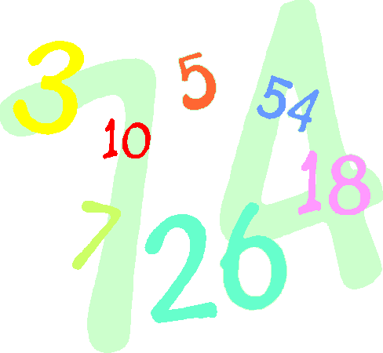
Any base to any base
1st - Convert the number you want
to convert to Base 10.
2nd - Convert the Base 10 result to the
new base you want.

Slide 10
Binary
 | Binary digits
Base 10 | 8 | 4 | 2 | 1
1 | 0 | 0 | 0 | 1
2 | 0 | 0 | 1 | 0
3 | 0 | 0 | 1 | 1
4 | 0 | 1 | 0 | 0
5 | 0 | 1 | 0 | 1
6 | 0 | 1 | 1 | 0
7 | 0 | 1 | 1 | 1
8 | 1 | 0 | 0 | 0

Slide 11
Base 2 to Base 16
There is a direct conversion from base 2 to base 8 & base 16 without using base 10.
8 and 16 are powers of 2 so they convert
directly.

Slide 12
Base 2 to Base 16
Base 2 converts directly to base 16 as each
4 bit section of base 2 equals one base 16
digit.
1111 = 15 15 is maximum single digit for 16
10 11
1010 1011 = AB in base 16
1 4 10
0001 0100 1010 = 14A in base 16
HEX
A – 10
B – 11
C – 12
D – 13
E – 14
F – 15

Slide 13
Base 2 to Base 8
Base 2 converts directly to base 16 as each
3 bit section of base 2 equals one base 8
digit.
111 = 7 7 is maximum single digit for base 8
5 3
101 011 = 53 in base 8
1 2 7
001 010 111 = 127 in base 8
8

Slide 14
Java Base Conversion
OUTPUT
324 base 6 == 124 base10
124 base10 == 7c base16
1011010
132
5A
int base10 = Integer.parseInt("324",6);
out.print("324 base 6 == ");
out.println(base10 + " base10");
out.print("124 base10 == "); out.println(Integer.toString(base10,16)+" base16\n\n");
out.println(Integer.toBinaryString(90));
out.println(Integer.toOctalString(90));
out.println(Integer.toHexString(90).toUpperCase());

Slide 15
javabase.java

Slide 16
Addition Substraction
Any Base

Slide 17
Any Base Math
145
+ 345 base 8
512 base 8
149
+ 345 base 12
492 base 12
427
345 base 9
72 base 9

Slide 18

Bitwise – Binary Operators
& | ^ << >>
These operators manipulate the binary digits
of variables.

Slide 19
Operator Precedence
() | HIGH
! ++ --
* / %
+ -
<< >> (bitwise shifts)
< <= > >=
== !=
& (bitwise and )
^ (bitwise xor )
| (bitwise or )
&&
||
= += -= *= /= %=
, | LOW

Slide 20
Bitwise AND
binary representation
 | 8 | 4 | 2 | 1
one | 1 | 0 | 0 | 0
two | 0 | 1 | 1 | 1
result | 0 | 0 | 0 | 0
int one=8;
int two=7;
out.println("8 & 7 == " + (one&two));
OUTPUT
8 & 7 == 0

Slide 21
Bitwise OR
binary representation
 | 8 | 4 | 2 | 1
one | 1 | 0 | 0 | 0
two | 0 | 1 | 1 | 1
result | 1 | 1 | 1 | 1
int one=8;
int two=7;
out.println("8 | 7 == " + (one|two));
OUTPUT
8 | 7 == 15

Slide 22
Bitwise XOR
binary representation
 | 8 | 4 | 2 | 1
one | 1 | 0 | 0 | 0
two | 0 | 1 | 1 | 1
result | 1 | 1 | 1 | 1
int one=8;
int two=7;
out.println("8 ^ 7 == " + (one^two));
OUTPUT
8 ^ 7 == 15

Slide 23
bitwiseand.java bitwiseor.java bitwisexor.java

Slide 24
Bitwise SHIFT LEFT
16 | 8 | 4 | 2 | 1
0 | 1 | 0 | 0 | 0
1 | 0 | 0 | 0 | 0
int one=8;
out.println("8 << 1 == " + (one<<1));
SHORTCUT
<< 1 multiplies by 2
OUTPUT
8 << 1 == 16

Slide 25
Bitwise SHIFT RIGHT
16 | 8 | 4 | 2 | 1
0 | 1 | 0 | 0 | 0
0 | 0 | 1 | 0 | 0
int one=8;
out.println("8 >> 1 == " + (one>>1));
SHORTCUT
>> 1 divides by 2
OUTPUT
8 >> 1 == 4

Slide 26
shiftleft.java
shiftright

Slide 27
Work on Programs!
Crank
Some Code!

Slide 28
A+ Computer Science
Number Systems

